Slide 1


SEICHE 2023 Intermediate Arduino Programming for IoT
Instructor: Paul Frommeyer
www.paulfrommeyer.com
Corporate Sponsor: DXC Technology

Slide 2
Lesson Plan Overview
Lesson 1: 7Feb23 – Review, Addressing, and Pointers
Overview of lesson plan
Class Exercise: Validation of sketch uploading
Class Exercise: Validation of binary create and upload
More on the Preprocessor
Memory Organization and Variables
Review of addressing and pointers
Using pointers to variables
Declaring pointers in function calls
Call-by-value Function Calls
Call-by-reference Function Calls
Lesson 2: 14Feb23 – More Gory Details
Class Exercise: Call-by-reference variables
Introduction to Complex Data Structures
Using complex data structures
Storage declarations and Arduino
Lesson 3: 21Feb23 – Fonts Redux
Class Exercise: Using complex data structures
Introduction to linked lists
Linked list usage example
Bitmap font architecture review
MD_Parola library font usage review
The MD_Parola font format
Designing your own fonts
Declaring your own fonts
Using your own fonts with MD_Parola
Lesson 4: 28Feb23 – Intro to Visual Studio Code
Introduction to VSC
https://code.visualstudio.com/docs/introvideos/overview
Installation
Lesson 5: 7Mar23 – Filesystems
Introduction to mass storage filesystems
The SD FAT, FAT16, and FAT32 filesystems
The exFAT filesystem
Introduction to SPIFFS
Class Exercise: Using SPIFFS
Lesson 6: 14Mar23 – WiFi
Review of WiFi technology (but no gory details)
Class Exercise: Review of WiFi access with WiFi Manager
Creating access points with ESP8266
Class Exercise: Creating an access point
Lesson 7: 21Mar23 – Web Technology
Introduction to HTML
Web server and client architecture
Creating web servers with ESP8266
Class Exercise: A basic web server for time and temperature
Lesson 8: 28Mar23 – Arduino Web Services
Storing web pages using SPIFFS
HTML forms
Form processing with Arduino
Class Exercise: Displaying text entered on a web page
Obtaining weather information from the Internet
Class Exercise: Displaying weather information
Lesson 9: 4Apr23 – IoT Messaging and MQTT
Introduction to IoT network messaging and MQTT
Subscribing to an MQTT service
Publishing to an MQTT service
Class Exercise: Using MQTT and WiFi
Lesson 10:11Apr23 – Version control and Git
The need for document version control
The Git version control system
Installing Git
Using Git
Introduction to Github
Using Github
Class Exercise: Signing up for a Github account
Lesson 11:18Apr23 – Using VSC
VSC plugin review
Using VSC with Arduino
Using VSC with Git

Slide 3











New Flash Drive Addition
What is HackSpace magazine? HackSpace magazine is the new monthly magazine for people who love to make things and those who want to learn. Grab some duct tape, fire up a microcontroller, ready a 3D printer and hack the world around you!
Digital copies in PDF for all issues are published free online for download
Since educational use is encouraged, I have compiled all 63 issues (to-date) and placed them on your flash drives for your entertainment and reference
https://hackspace.raspberrypi.com/issues?page=1
HackSpace Magazine

Slide 4
Lesson 2 – Pointers, Complex Data Structures
Part A
CLASS EXERCISE – LESSON 1 REVIEW
Part B
Introduction to complex data structures
Declaring data structures with struct
Accessing structure members
The typedef statement
Using struct and typedef
Declaring data structures with union
Layered data structures

Slide 5
CLASS EXERCISE – SKETCH 2A
Go ahead and load SKETCH2A into your IDE
Study the preprocessor directives at the beginning of the sketch
Study the call-by-reference example using pointers to char
#define DISPLAYMSG "Welcome to SEICHE 2023"
#ifndef DISPLAYMSG
#define DISPLAYMSG "BENGALS FTW 2023!"
#endif
#define CBR Foo
char displaytext[] = DISPLAYMSG;
void showmsg(char *msg)
{
#ifdef DISPLAYMSG
msg = "COLTS FTW 2024!";
#endif
pmx.displayText(msg,PA_LEFT,50,0,PA_SCROLL_LEFT,PA_SCROLL_LEFT);
}
// stuff removed
void loop()
{
if(pmx.displayAnimate())
{
showmsg(displaytext);
pmx.displayText(displaytext,PA_LEFT,50,0,PA_SCROLL_LEFT,PA_SCROLL_LEFT);
}
}
Upload the sketch. What were your results, and why?
Next, modify your sketch to not alter the message by changing an appropriate #define
Lastly, change the modification of the passed variables in showmsg().

Slide 6
Complex Data Structures
A complex data structure is a combination or “grouping together” of different variables of different types into a single data structure
The statement that is used to accomplish this grouping is the struct directive. This directive creates a complex data type. The complex data type works similar to other data types like int and char.
Syntax: struct structurename
{ member1 type member1 name; member2 type member2 name; }

Slide 7
Complex Data Structures (cont)
Example 1 struct point
{ int x-coordinate; int y-coordinate; }
Example 2 struct student_record
{ char* name; int grade_science; int grade_english float gpa; }

Slide 8
Complex Data Structures (cont)
Accessing structure members struct point
{ int x-coordinate; int y-coordinate; } struct point coordinates; coordinates.x = 10; coordinates.y = 20;
Note that before it can be used, a variable must be declared of that type. In this case coordinates is the variable, and it is of type “point”.
Member access has the form structurename.membername Note the use of the period to separate the two entities
Since members are of standard variable types, the same operations can be performed on a member as can be performed on any other variables of that type

Slide 9
Pointers to Structures
The most common use of structures is to pass an entire structure to a function using call-by-reference. A pointer to the structure is passed, thus, the variable that is declared is a pointer to that type of structure.
Pointers to structures struct point
{ int x-coordinate; int y-coordinate; } struct point *coordinates; // Note the * makes this a pointer
Because this is largely what structures were made for, a special operator is used to dereference a pointer to a structure and access a member all in one go: pointer_to_structure->membername thus coordinates->x = 88;

Slide 10
The TYPEDEF statement
The typedef statement provides a way to “alias” an existing data type to a different name. This is most commonly used with pointers as seen below
Syntax: typedef datatype aliasname
Example typedef char *MyString
The preceding example will allow the declaration of strings, as pointers to char, like this: MyString somestring;
Typedefs just add a new name for an existing data type. They do not create new data types in any sense.

Slide 11
typedef and struct
typedef is frequently used with structures to easily declare and use pointers to those structures, thusly:
typedef struct point {int x; int y;} Coordinates;
typedef Coordinates *2D_Coordinates;
The previous code will first declare Coordinates as an “alias” for struct point. This “alias” is then used to declare the variable 2D_Coordinates as a pointer to data type struct point.

Slide 12
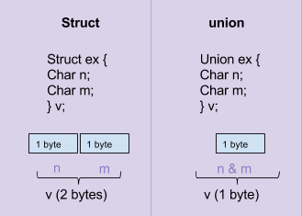
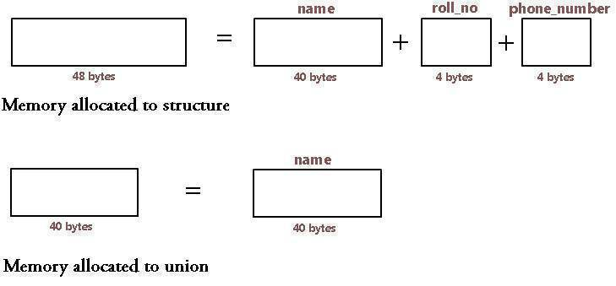
The union declaration
The statement union is used to declare overlapping member variables. That is, the memory storage for the members in a union overlap each other. This can be a powerful way to treat multiple variables as a single “block” of data storage. The syntax is nearly identical to struct:
Syntax: union structurename
{ member1 type member1 name; member2 type member2 name; }

Slide 13
union and layered data structures
IP addresses, which are used to uniquely identify hosts on a computer network, consist of four integers. In fact, these integers are bytes, and can only hold values from 0-255. Separating the individual bytes with periods, to form a “dotted quad”, is what tells us we’re looking at an IP address: 172.12.9.223 or 192.168.127.252
Internally, IP addresses are handled by nearly all computers as 4-byte integers. However, at the human/user level, we prefer to use those dotted quads.
Unions are terribly useful for manipulating these: struct dotquad { byte quad1; byte quad2; byte quad3; byte quad4; }; union ipaddress { dotquad ipaddr; uint32_t integer_address; }
Note the separate declaration of dotquad to hold the individual bytes. This is necessary to ensure that the bytes of the IP address are stored sequentially in memory. If the bytes were declared “bare” in the union, then they would all overlap each other as well as the first byte of integer_address. This is an example of a layered or hierarchical data structure with more than one “level”.

Slide 14
Storage Classes
Auto – Default storage class for variables in functions. Used to declare dynamic allocation for the variable, in Arduino IDE compiler, does nothing, and is rarely if ever used.
Register – Tells the compiler to store the variable in a microcontroller register rather than memory. This allows faster access and processing of the variable data, and thus faster execution. The compiler does this automagically, so it’s rarely used.
Static - variables declared in functions “die” when you exit the function in which they are defined. This means that each time the function is called, a new set of these variables is created. This also means that any values for the variables in the function from the previous execution of the function’s code are lost. The static storage class prevents this from happening and allows the variable contents to “persist” across function calls. You could also use a global variable to do the same thing, as all globals are static.
Extern - is a storage class modifier that tells the compiler that the variable is defined in a different source code file but let’s me use it in the current file as a variable of whatever type. Used in heavy-duty coding with multiple source files in a single project, which is Advanced Programming so not covered here.
Syntax: [storage-class] data-type variable-name Example: static int totalpixels;
NOTE: The avr-objdump.exe program and documentation exist in the Tools directory for dumping AVR object files to inspect the generated code. Waaaaay beyond this class!!!

Slide 15
Formal End of Lesson 2
HOMEWORK
Have a look at the new HackSpace magazines added to your flash drives!
In next week’s exciting episode
Class Exercise: Using complex data structures
Introduction to linked lists
Linked list usage example
Bitmap font architecture review
MD_Parola library font usage review
The MD_Parola font format
Designing your own fonts
Declaring your own fonts
Using your own fonts with MD_Parola

Slide 16
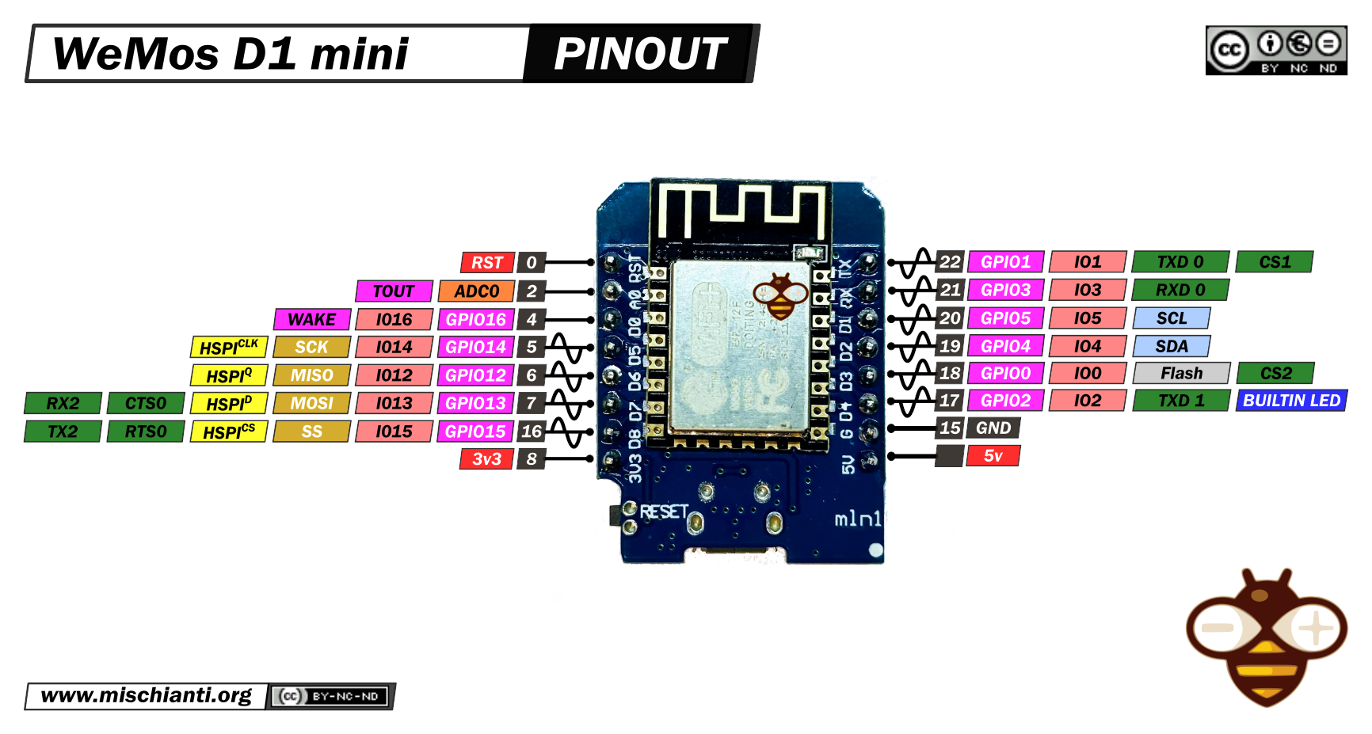
Our Microcontroller: The WeMos D1 Mini
Hilights
11 digital IO: all are interrupt and pwm capable (except D0/GPIO16)
1 analog input (3.2V max input): A0/ADC0
Micro USB or Type-C USB Port (clones usually have micro USB)
Two SPI interfaces (one is used for on-board flash memory), one I2C interface, two serial ports
Built-in WiFi (client or standalone access point modes) and Bluetooth
Compatible with MicroPython, Arduino, NodeMCU
Uses the CH340 USB-to-serial driver (installation usually needed on Windows)
Extremely low cost (approx $3.00 US on Amazon; one of the two least expensive components in your kits)

Slide 17
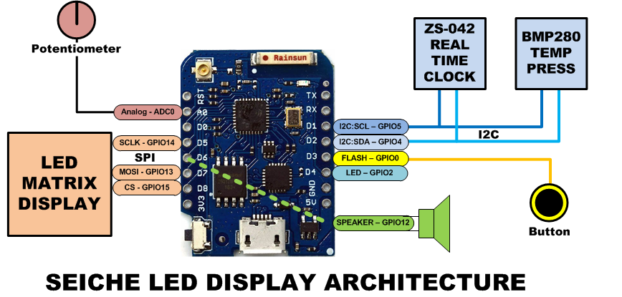
SEICHE LED Display Architecture
Red MAX7219 8x32 LED matrix display (SPI)
ZS-042 real-time clock module (I2C)
BMP280 Temperature and Pressure Sensor (I2C)
Piezoelectric speaker (PWM)
10KΩ Potentiometer (Analog-to-Digital Converter)
Button (Pullup and interrupt)

Slide 18
sprintf() Function Syntax
sprintf()’s formal syntax is: sprintf(char *buffer, const char *format, variable list)
buffer is an array of type char (the parameter when passed can also be a pointer [address] for such an array) which will contain the formatted output of the function
format is an unmodifiable (constant) array of char containing the format descriptors for all variables subsequently passed to the function, which is to say, it’s the format string.
The variable list are just the comma separated variables that are to be formatted
All variables passed in a single call to sprintf() are combined into a single output string
sprintf() automagically puts a terminating NULL (\0) at the end of the ASCII output

Slide 19
sprintf() Format Strings
sprintf() format strings contain conversion specifiers that specify how each individual variable is to be converted
sprintf() conversion specifiers have the following general syntax (all begin with a percent-sign):
%[flags][minimum field width][.][precision][length][conversion character]
% - special token that indicates the start of a conversion specifier
Flags – these modify the behavior of the specification
Minumum field width – as it says on the tin; this the minimum number of characters to be converted
. – The period is a separator between field width and precision
Precision – means one of the following depending on the variable type and conversion specifier
The maximum number of characters to be generated from a string
The number of digits after the decimal point for type float conversions (e, E, or f)
The zero-filled minimum number of digits for an integer
Conversion character – A single character which determines the output type of the conversion specifier; a single character that specifies the type of output format for the corresponding data or variable

Slide 20
sprintf() Conversion Specifiers
Below are the general conversion specifiers and what they do.
Specifier | What it does
d, i | int - integer; signed decimal notation
o | int – unsigned octal (no leading zero)
x, X | int – unsigned hexadecimal, no leading 0x
u | int – unsigned decimal
c | int – single character, after conversion to unsigned char
s | char * - characters from string are printed until \0 (NULL) or precision is reached
f | double – decimal notation of form [-]mmm.ddd where number of decimals is specified by precision; precision of zero (0) suppresses the decimals altogether
e, E | double - exp notation; default precision of 6, 0 suppresses
g, G | double – Use %f for <10^4 or %e for >10^4
p | void * - print output as a pointer, platform dependent
n | Number of characters generated so far; goes into output
% | No conversion, put a % percent sign in the output

Slide 21
sprintf() Conversion Specifiers
Below are the flags and what they do.
Flag | What it does
- | Left justification
+ | Always print number with a sign
spc (space) | Prefix a space if first character is not a sign
0 (zero) | Zero fill left for numeric conversions
# | Alternate output form depending on conversion character o – first digit will be zero x or X – 0x or 0X (respectively) prefixed to non-zero results e, E, f, g and G – Output will always have a decimal point g and G – trailing zeroes will never be removed

